Slide 1

KARNATAK LAW SOCIETY’S VISHWANATHRAO DESHPANDE INSTITUTE OF TECHNOLOGY HALIYAL [U.K] -581329
DEPARTMENT OF COMPUTER SCIENCE AND ENGINEERING
INTERNSHIP REPORT ON
Enotes Managment System
GUIDED BY :
Prof. Farzana Nadaf Prof.Karthik K
PRESENTED BY:
Shashank Baikadi 2VD19CS043
DEPARTMENT OF COMPUTER SCIENCE AND ENGINEERING, KLS VDIT, HALIYAL

Slide 2
INTRODUCTION
Varcons Technologies Private Limited is a Private incorporated on 11 July 2022. It is classified as Non-govt company, Bangalore.
Directors of Varcons Technologies Private Limited are Chikaegowdanadoddi Kariyappa Somalatha and Haralahalli Chandraiah Spoorthi.
Varcons Technologies is a technology Organization providing solutions for all web design and development, MYSQL, PYTHON Programming, HTML, CSS, ASP.NET and LINQ.
Motto of organization is to “Collaborate with our clients to provide them with best Technological solution hence creating Good Present and Better Future for our client which will bring a cascading a positive effect in their business shape as well”.

Slide 3
Overview
I have completed the internship from Varcons Technologies Bangalore on the topic “Full stack web development ”.
The duration of internship was 36 days from 23 august 2022 to 27 September 2022. It was an online internship.
The field on which I was working was Full stack development. Firstly, I was trained on the basic concepts of Django,Html,Css,Js language in the first week.
Then, I was trained on the concepts of basics of web, Git and Github and Backend concepts.
I was trained on various types of conceptslike frontend,backend,web designing and so on.
I was been assigned assignment every week which were to be submitted at the end of every week.
Lastly, I was assigned a project to work using the concepts of full stack development.

Slide 4
Training Program
Frontend Development
Frontend development refers to the part of web development that deals with creating the user interface of a website or web application that users interact with directly. This includes designing and developing the layout, structure, and functionality of a website’s user interface using HTML, CSS, and JavaScript. Frontend developers work closely with designers to ensure that the website or application is visually appealing and easy to use. They also ensure that the website or application is responsive and works well across different devices such as desktops, tablets, and smartphones.

Slide 5

Training Program
Backend development
Backend development refers to the server-side of web development where the logic of the application is implemented. It involves writing code that interacts with databases, APIs, and other server-side technologies
Django is a high-level Python web framework that is commonly used for backend development. It provides a clean and pragmatic design that encourages rapid development. Some of the benefits of using Django for backend web development include its Representational State Transfer (REST) framework, which is a popular toolkit for building APIs. Django’s REST framework can be assessed from the fact that it takes just three lines of code to build a ready-to-use API.
Responsive webpage is a website that is designed to look good and function well on all devices, including desktops, tablets, and mobile phones. Responsive web design uses code that automatically adjusts the design to different screens based on their sizes and resolutions. This allows users to have a smooth experience of a web page regardless of whether they’re viewing it on a wide desktop monitor or small mobile screen

Slide 6
Implementation of project
Problem Statement
It is the user friendly application for helps to efficiency by reducing the time and resources required to manage and process electronic notes. To make electronic notes more accessible to authorized users, regardless of their location. To provide a centralized location for all electronic notes, making it easier to find and access important information.
The main objective of the objective of an eNotes management system is to provide a comprehensive solution for managing electronic notes, making it easier for users to stay organized, efficient, and productive in their work

Slide 7
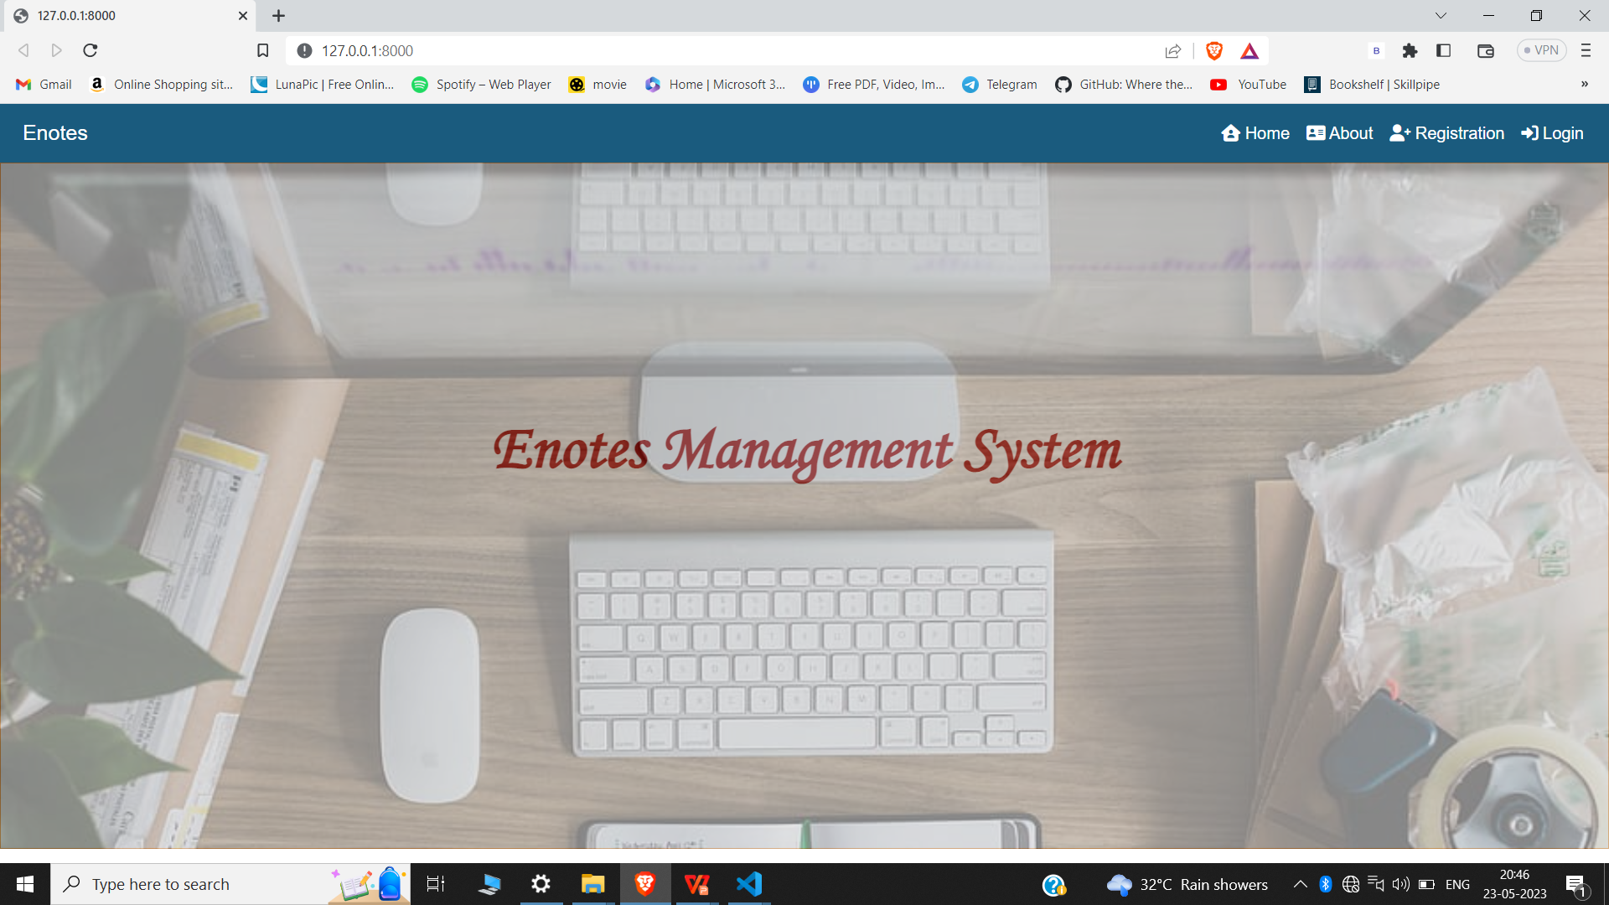
Snap shot

Slide 8
CONCLUSION
The internship was a good learning opportunity. I am aware of the different web technologies, business information, and other requirements. I've been inspired to create web apps throughout my entire internship. My flaws and strong points have been identified. During my internship, I had a variety of work situations that helped me learn more about Web and work life.
I was able to use the concepts I had learned on the tasks once my internship was over. "Enotes Management System " was the topic on which I worked during my internship. Enotes Management System application helps to efficiency by reducing the time and resources required to manage and process electronic notes.

Slide 9


